Slide 1

Enhancing Aviation Safety: Insights from Comprehensive Analysis
By mahmoud Mustafa

Slide 2

Introduction
Overview of Presentation
Importance of Aviation Safety
This presentation will focus on our comprehensive analysis of airplane crashes and fatalities using Power BI for data-driven decision making.
Aviation safety is vital for global connectivity, economic growth, and public confidence in air travel.

Slide 3
Problem Statement
Objective
Dataset
Goal
To conduct a comprehensive analysis of airplane crashes and fatalities from 1980 to 2023 using Power BI for data-driven decision making.
Key information includes crash dates, locations, operators, aircraft types, and fatality statistics.
Leverage Power BI for interactive visualizations to understand patterns and trends in aviation incidents and improve safety measures.

Slide 4

Dataset Description
Fields
Importance
The dataset includes crucial information such as crash dates, locations, operators, aircraft types, registration details, passenger and crew statistics, and incident summaries.
Each field provides invaluable insights into the circumstances surrounding aviation incidents and enables informed decision-making for safety enhancements.

Slide 5
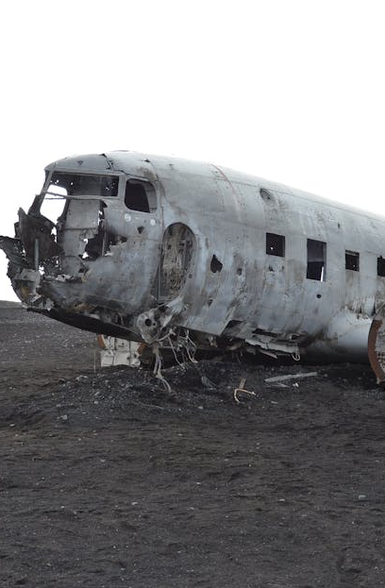
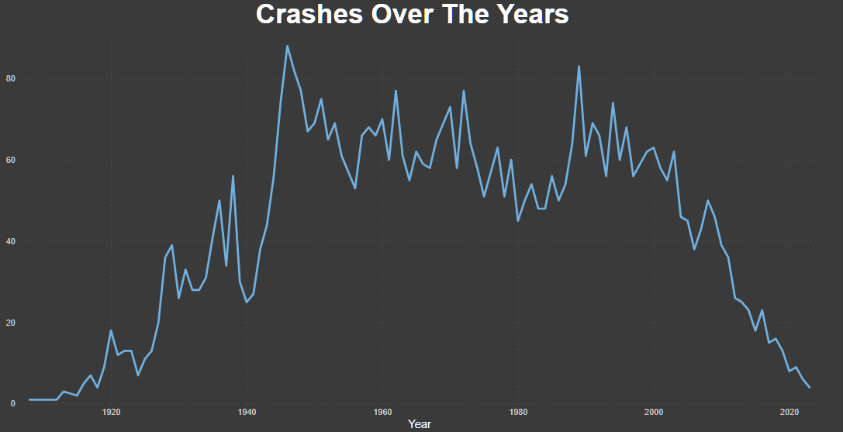
Crashes over years
This report shows that the period between the 1945 and to the beginning of 21th century has highest rates of crashes where the safety Aviation there was not like today

Slide 6
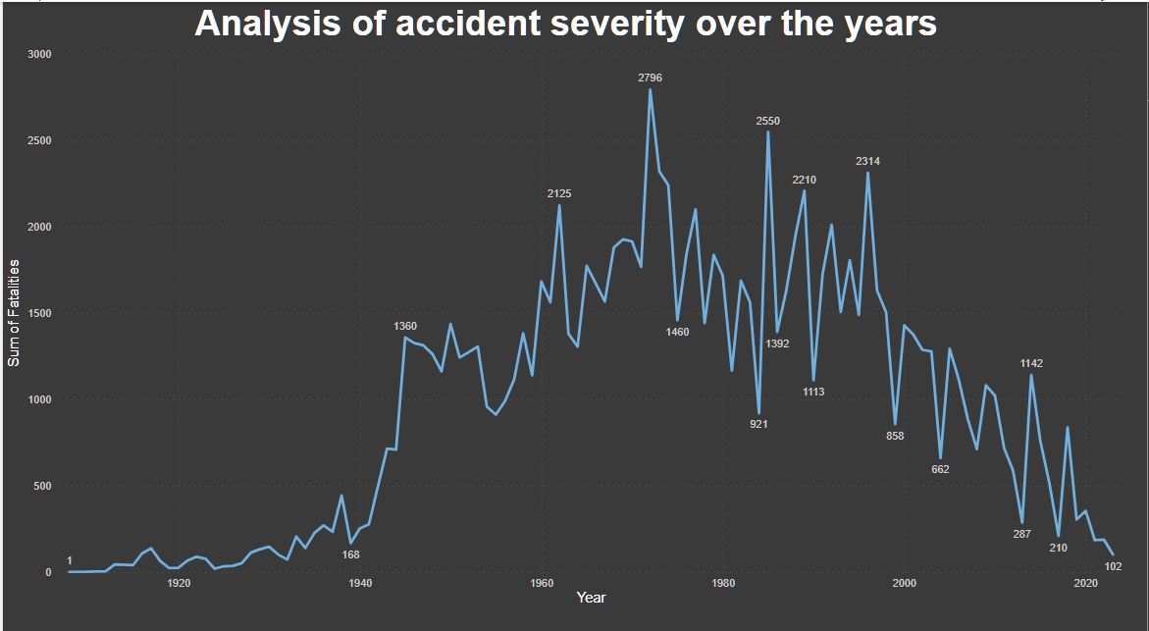
Accidents severity
In this report we see that the severities rates have its highest in 1972 , and in 1985 and continued in decreasing until in 2023 hit 102 because of the development happened among all these years

Slide 7
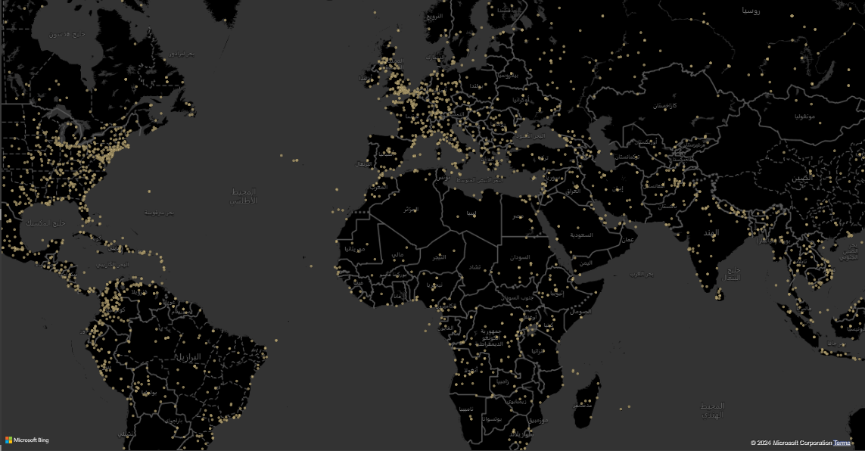
Location is a factor?
We see in the map that the most common crashes were between coast places or on boundaries of coast places such as the Mediterranean sea and also between south, north America, so absolutely yes!, the location is factor and it is the most important factors

Slide 8
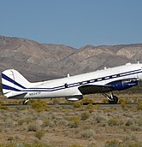
The aircraft
From reports we saw that the Douglas DC-3 had the highest crashes rate, as it hit more over 300 flights!
The Douglas DC-3, though historically significant, has been associated with a higher number of crashes due to its aging design and technology compared to modern aircraft.

Slide 9
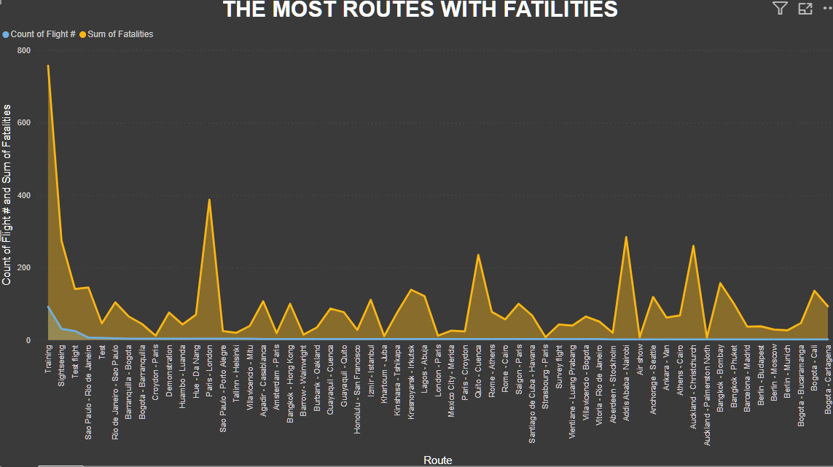
Routes as factors
From the report, guess what is the route with the highest rate of fatalities?, yes, the training area.
This suggests that incidents occurring during training exercises may contribute significantly to the overall fatality rate in aviation incidents.

Slide 10
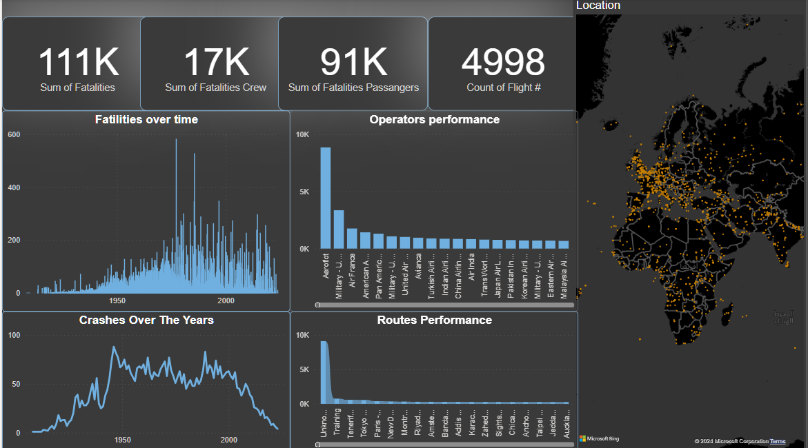
dashboard

Slide 11

Conclusion
Thank You
Thank you for your attention. Please feel free to ask any questions or share your insights on enhancing aviation safety through comprehensive analysis.

